Slide 1
FINANCIAL AID 101
Kristen Isaksen
Associate Director of Financial Aid
Monmouth University

Slide 2
Topics We’ll Cover
Terms & tools
Completing the 2020-21 Free Application for Federal Student Aid (FAFSA)
Types & sources of aid
Aid programs
Tips

Slide 3
File the FAFSA fafsa.gov
Applications accepted starting October 1
File each year for each student in college
Use income from 2 years prior
2018 income for the 2020-21 FAFSA

Slide 4
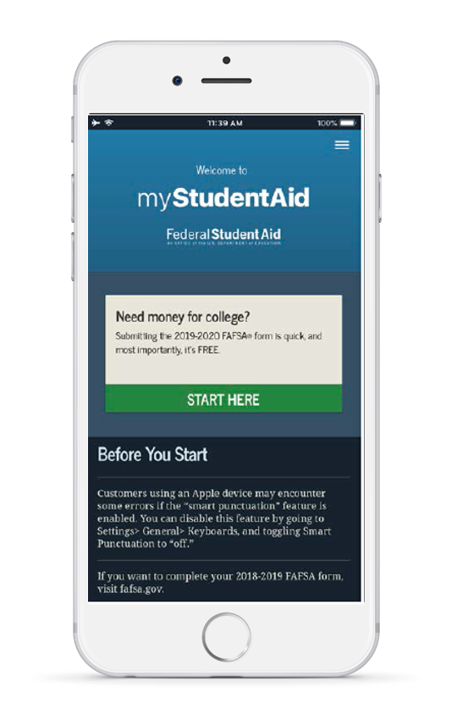
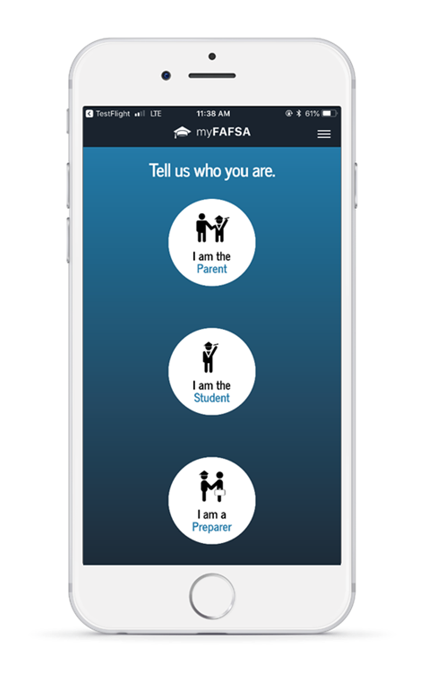
myStudentAid Mobile App
Android or Apple
Must have FSA ID
Save, complete & submit the FAFSA
IRS DRT available

Slide 5
Federal Methodology
Federal Methodology
Formula created by Congress, uses all information on the FAFSA.
Determines the Federal Expected Family Contribution (EFC).

Slide 6
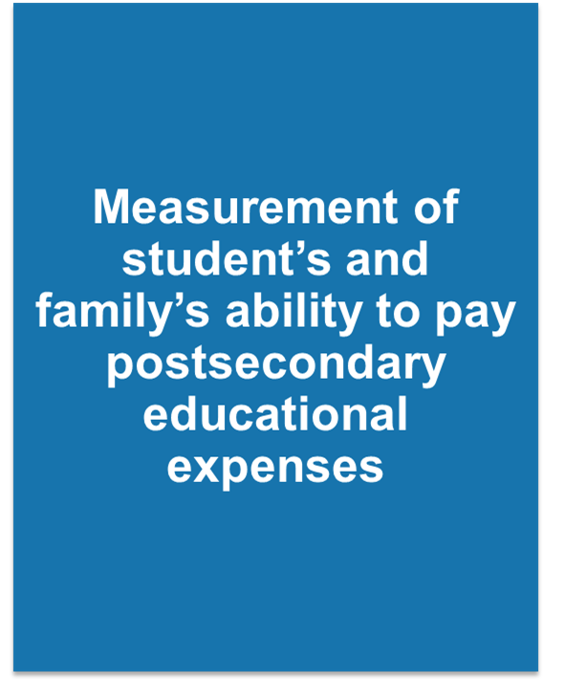
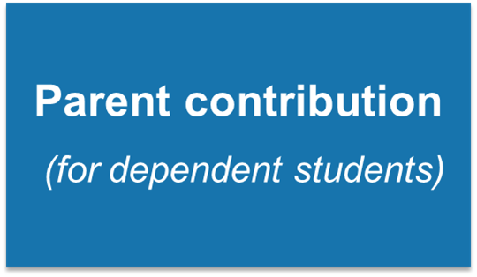
Expected Family Contribution (EFC)

Slide 7
Expected Family Contribution (EFC)
Index number that the financial aid office uses to determine aid eligibility
Stays the same regardless of college choice
The EFC is not:
The amount of money you will pay
The amount of federal aid you will receive

Slide 8
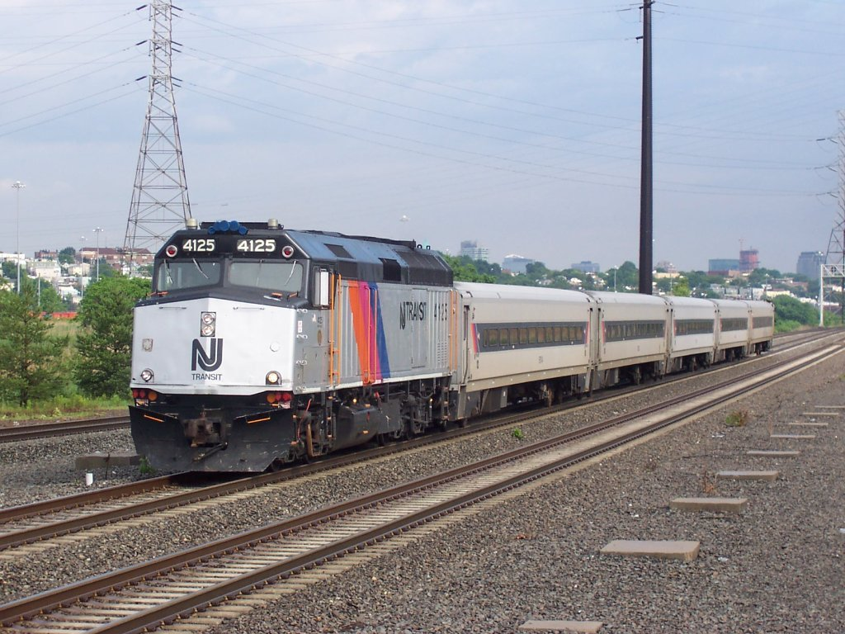
Cost of Attendance
Direct Expenses
Indirect Expenses
Tuition and fees
Room and meal plan (on campus)
Books and supplies
Transportation
Personal expenses

Slide 9
Definition of Need
Cost of Attendance (COA)
- Expected Family Contribution (EFC)
= NEED

Slide 10
Financial Need Examples
Cost of Attendance | $40,000
- EFC | $15,000
= Need | $25,000
Cost of Attendance | $65,000
- EFC | $15,000
= Need | $50,000

Slide 11
Net Price Calculator
Want to get an early estimate of your aid at a particular college?
Complete for each college in which you are interested
Provide income information
Gives you an estimate of the aid for which you are eligible
Also provides cost information
https://collegecost.ed.gov/net-price

Slide 12
FAFSA4caster fafsa.gov

Slide 13
FSA ID fsaid.ed.gov
Username and password
Legal signature on the FAFSA
Access to other U.S. Department of Education sites
Student and 1 parent need an FSA ID
Email address and mobile phone number cannot be used with more than one FSA ID

Slide 14
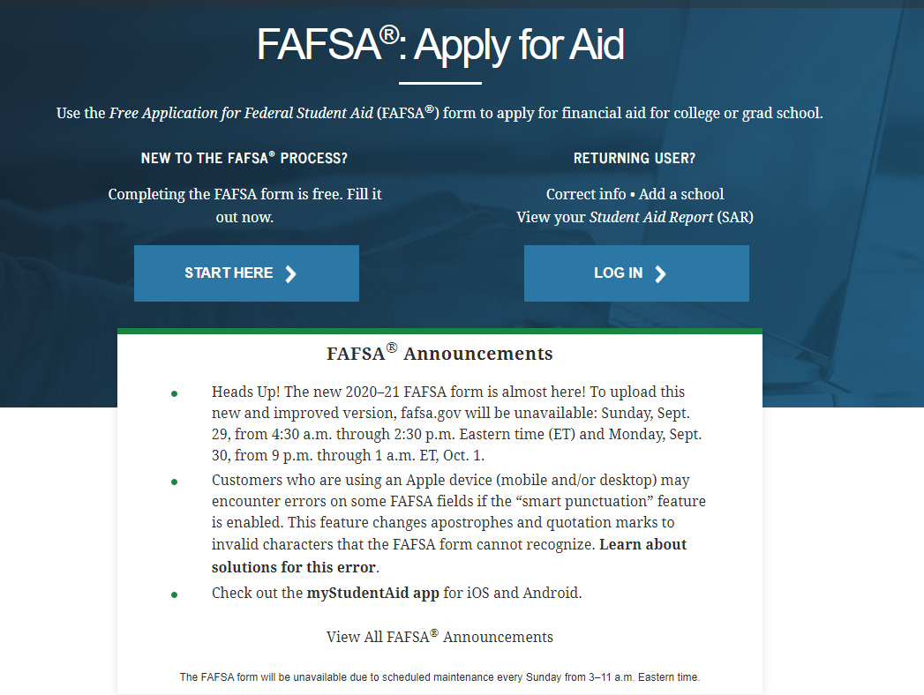
FAFSA on the Web www.fafsa.gov

Slide 15
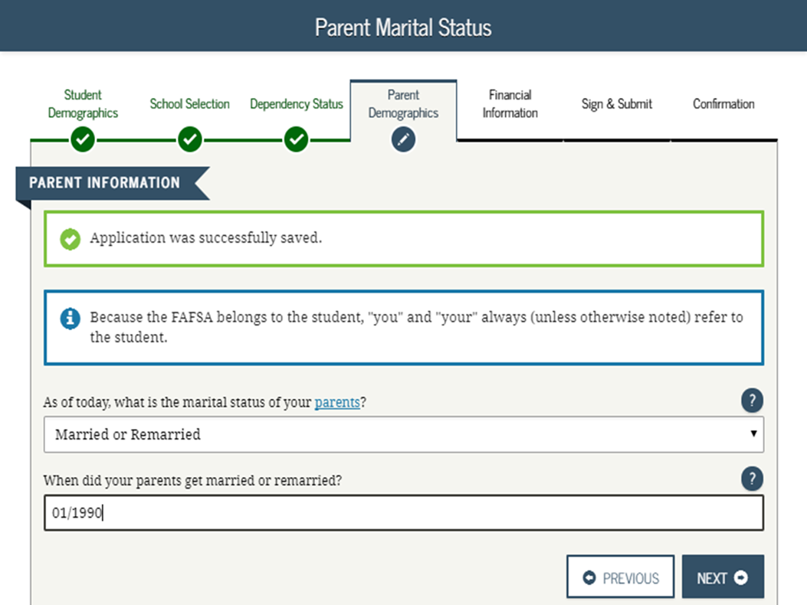
FAFSA on the Web

Slide 16
General Eligibility Requirements - Students
Earn a high school diploma or equivalent.
Accepted for enrollment in an eligible program.
Must be U.S. citizen or eligible non-citizen.

Slide 17
General Eligibility Requirements - Students
Must have valid Social Security Number (SSN)
www.ssa.gov
Must be registered with Selective Service (if male and required)
www.sss.gov

Slide 18
Completing the FAFSA
Student demographic information
SSN
Citizenship status
Marital status
State of legal residence
Drug conviction status
Selective Service registration
Level of parents’ school completion

Slide 19
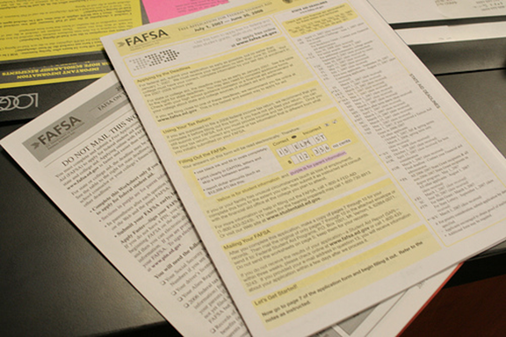
Completing the FAFSA
Student dependency status
Born before January 1, 1997
Married
Serving on active duty in the U.S. Armed Forces
Veteran of the U.S. Armed Forces
Since turning age 13
Both parents were deceased
In foster care
Dependent or ward of the court
Emancipated minor
In legal guardianship

Slide 20
Completing the FAFSA
Student dependency status
Working on a master’s or doctorate program
Having children who receive more than half of their support from you
Having dependents other than children who live with you and receive more than half of their support from you
Homeless or at the risk of being homeless
If none of these items apply to the student, they are dependent and will need to provide parent information.

Slide 21
Completing the FAFSA
Parent(s) Information
Marital Status (as of the day the FAFSA is completed)
Never married
Unmarried, both legal parents living together
Married or remarried
Divorced or separated
Widowed
Household size/# in college
SSN/Name/Date of Birth
State of legal residence

Slide 22
IRS Data Retrieval Tool
Applicants may submit a real-time request for IRS tax data.
The IRS will authenticate the taxpayer’s identity.
If a match is found, the IRS will send the results in real-time.
Applicants may choose whether or not to transfer the data.

Slide 23
IRS Data Retrieval Tool
Tips
Schools and state agencies can view the data
Screening question for IRA/pension rollovers
Joint filers manually enter income earned from work
Do not change the IRS data
Do NOT update the FAFSA to 2019 income!

Slide 24
Completing the FAFSA
Asset questions
As of the day the FAFSA is completed
Cash, savings and checking accounts
Investment net worth
Business/Investment Farm
List colleges to receive the information (up to 10)
Enter the FSA ID for student and parent

Slide 25
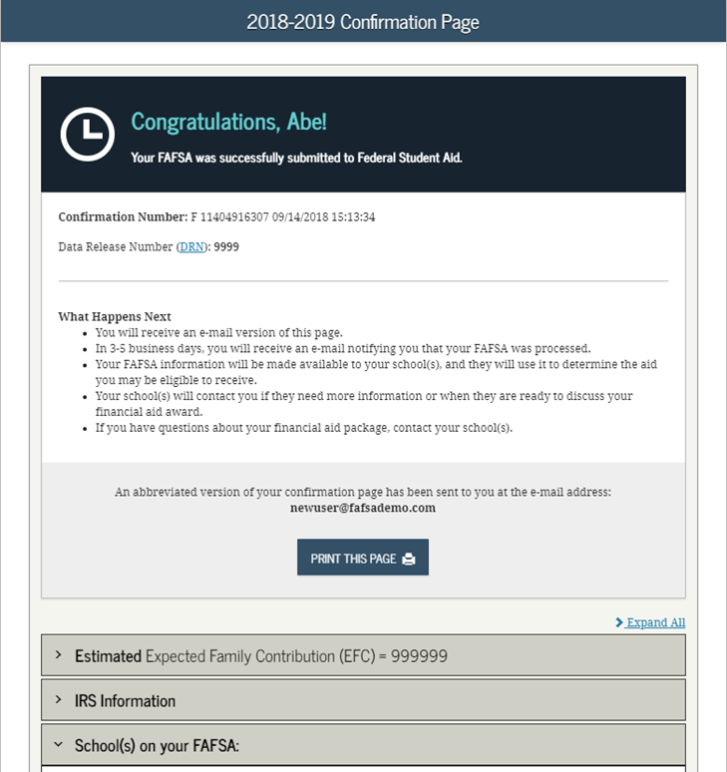
FAFSA Confirmation Page

Slide 26
Process
File Free Application for Federal Student Aid (FAFSA)
Use the DRT
Receive Student Aid Report (SAR)
Complete any institution specific applications
Receive/Return Financial Aid Award Letter
Provide Additional Documentation
Process Student Loans

Slide 27
Sources of Aid
Institutional
Merit based
Need based
Federal
State
Other
Athletic Scholarships
Outside Scholarships
Veteran’s benefits
Resident Assistantships
Tax Credits

Slide 28
Tax Credits
American Opportunity Tax Credit
Lifetime Learning Tax Credit
Tuition and Fees Deduction
Student Loan Interest Deduction

Slide 29
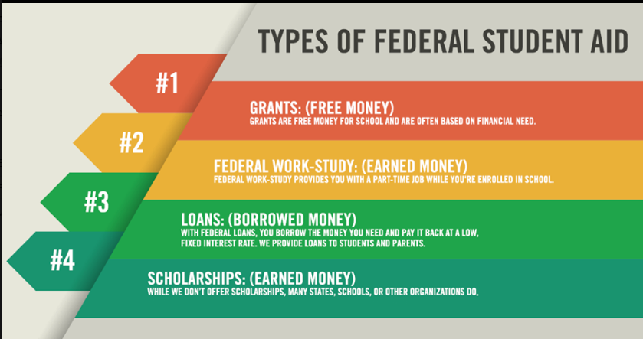
Types of Financial Aid

Slide 30
Grants and Scholarships
Federal
Federal Pell Grant
Federal Supplemental Educational Opportunity Grant (SEOG)
Teacher Education Assistance for College and Higher Education (TEACH) Grant
Iraq and Afghanistan Service Grants

Slide 31
Grants and Scholarships
STATE
New Jersey Tuition Aid Grant (TAG)
NJSTARS and NJSTARS II
Educational Opportunity Fund (EOF)
www.njgrants.org

Slide 32
More Grants and Scholarships
Private Sources
Think local and global
Use the Counseling Office’s Resources
Internet Resources
www.fastweb.com
www.scholarships.com
Only use free resources

Slide 33
Federal Direct Loan Program
Federal Direct Loan Program
Borrowed by the student
No cosigner, no credit check
Must file the FAFSA
Entrance counseling and master promissory note must be completed

Slide 34
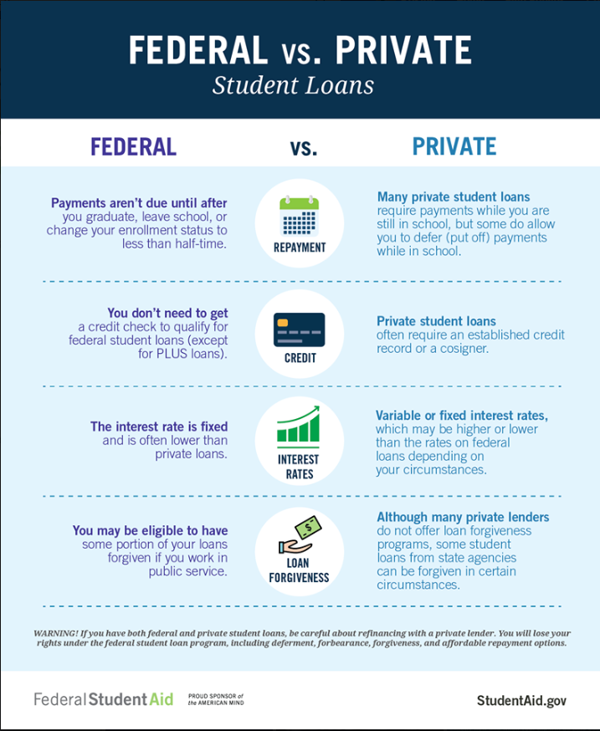
Supplemental Loans

Slide 35
Employment
Federal Work Study
Institutional Work Programs
Off-Campus Jobs

Slide 36
Tuition Payment Plans
Not a loan
Enrollment fee
Make tuition payments in monthly installments
Fit payments into your monthly budget
Various payment options

Slide 37
Tips
READ, READ, READ
all mail/email promptly
instructions carefully
review before submitting
Maintain copies of all documents
Do not sign your son or daughter’s name/FSA ID to financial aid documents
Involve your student
Consult a financial aid officer

Slide 38
Questions to ask a Financial Aid Administrator
Are institutional scholarship and grant awards renewable?
What are the policies for work-study positions?
Will an outside scholarship change my aid?
How can I use financial aid to pay for books?
What if there’s been a job loss, loss of untaxed benefit, or other change in circumstance?

Slide 39
Questions
Monmouth.financialaidtv.com
Studentaid.gov/resources

